Slide 1
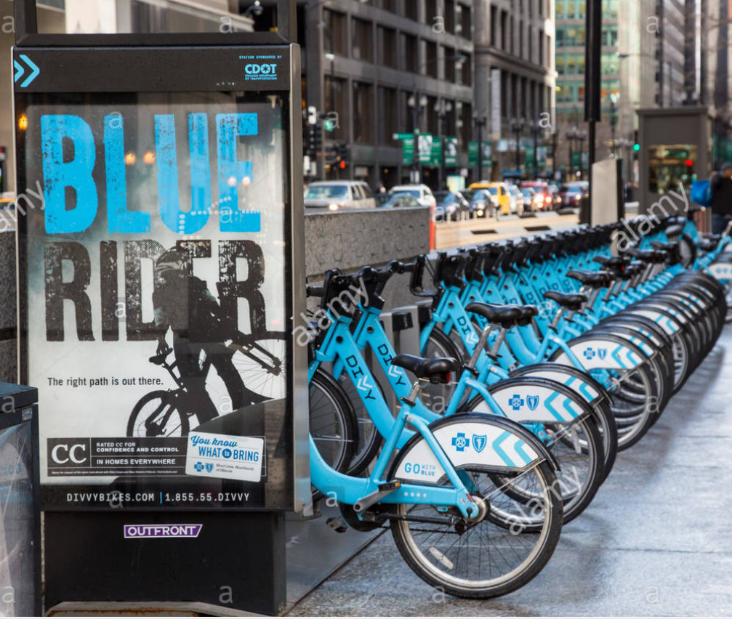
Divvy Bikes DIVVY BIKES ANALYSIS
Presenters
Manish Tandel, Karthik Kini, Mohit Roy, Harshit Paliwal, Radhika Barbole

Slide 2
INTRODUCTION
Divvy bikes is a rental system that contains a fleet of bikes parked at its docking stations.
In order to provide good services the company need to be aware of all the possible improvements that they can inculcate.
We have provided analysis and the solutions to four different business problems that will help Divvy improve its services.
The four problem statement as follows:
Identifying the need and feasibility between two stations for providing parking spaces at heavy stations.
Predicting the bikes availability on an hourly basis (making use of date, hour, no of trips).
Predicting whether or not to put a bike on maintenance on a given day by keeping various factors in mind like weather,
Predicting the need of docks on station based on the traffic at the station.

Slide 3
DATA ACQUISITION
To broaden the scope of the project and to get some experience with handling new datasets we have combined the weather dataset and a docks dataset.
Primary Dataset Description: It provides the details of the bike trips with attributes like tripId, stationId, Start date and Time, End date and Time, gender, birth year and more.
Secondary Dataset Description:
Docks Dataset- The primary dataset lacked the information on number of docks present on every station. Hence we used a docks dataset to add more value to the primary dataset.
Weather Dataset- We fetched the needed attributes about the weather like date, hour and WeatherIcon, from the weather data of Chicago using the “Dark Sky API”.
Bikes Availability- To fetch the bike availability records of each station on hourly basis, we made use of RSocrata API.

Slide 4

Primary Dataset Manipulations
DATA PREPARATION I
Secondary Dataset Manipulations
Set Names of all columns which were not aligned for merging
Merging Dock capacity dataset with the original data frame
Transform data present in quarterly form to a single dataset
Making use of RSocrata API to fetch records for the particular station.
Finding the missing percentage of each column values and removing those rows where missing percentage was less than 10%
Making use of Dark sky API for fetching weather data of Chicago.
Extracting only the required columns for analysis
Extracting attributes like Date, Hour, WeatherIcon from the API.

Slide 5
New Calculation
DATA PREPARATION II
Transformations
Calculation revenue from trip duration and customer type.
Bringing varied time stamp format to one format for analysis.
Calculating distance travelled using lat lon of origin and destination points.
Splitting Date and Time in two different columns using str_split
Added new variable of Dock_diff in order to visualize the difference between arrivals and departures at each station
Identifying missing values of each variable and removing those particular rows
Calculating Trip Duration from start and end time
Converting the trip duration variable from string to numeric and changed it in minutes.

Slide 6
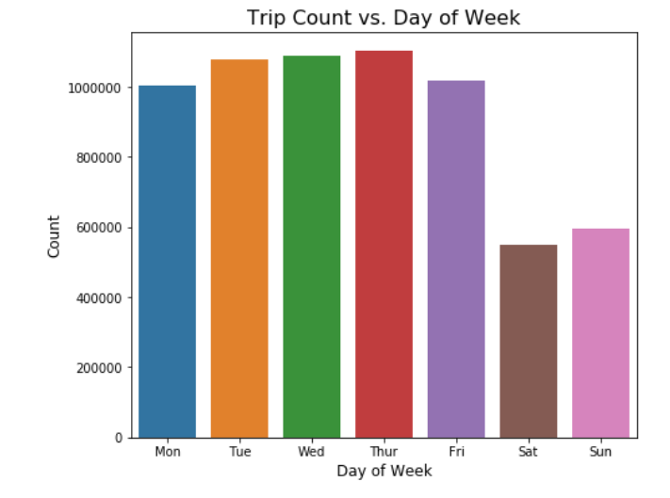
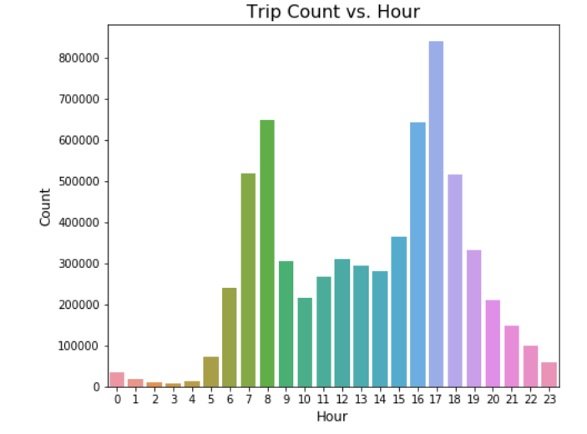
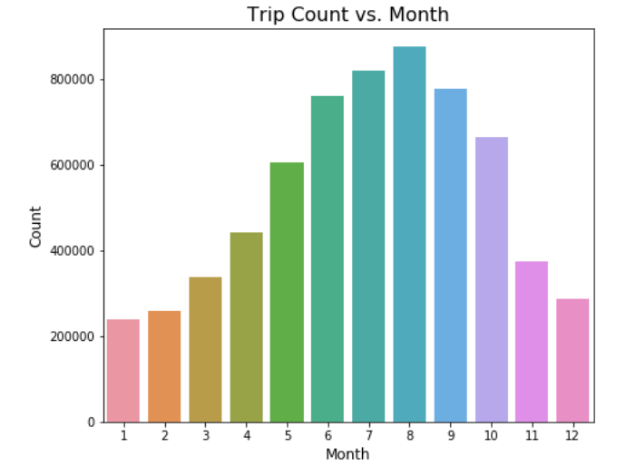
EXPLORATORY DATA ANALYSIS I
It is quite evident that usage of Divvy rental bikes increases during Summer which is quite obvious as Chicago being cold place people prefer to use rental bike when temperature is pleasant
Similarly, on weekends people are less likely to use Bike service in comparison to weekdays which can be observed from the histogram
Analyzing the hourly breakdown it can be observed bike usage peaks in the morning and evening time which can be associated to working hours of most of the people

Slide 7
EXPLORATORY DATA ANALYSIS II
Spatial distribution of number of trips from stations shows that central Chicago is the most used location and very less customer take Divvy bike in South side of Chicago which makes it potential place to advertise Divvy service in that region.

Slide 8

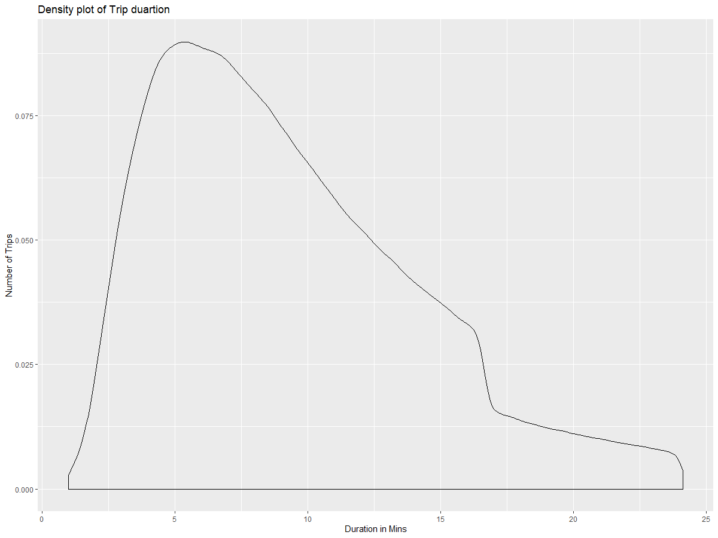
EXPLORATORY DATA ANALYSIS III
Few additional box plots and a density graph for our analysis.

Slide 9




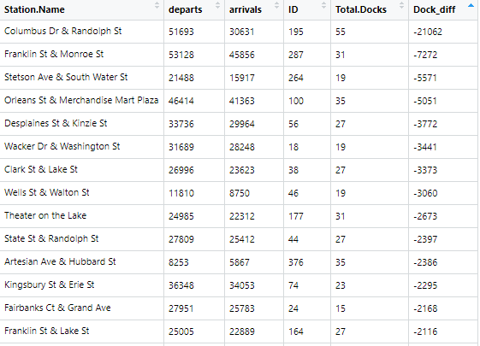

KNN Classification
Models for new station feasibility and need.
Multi Regression & Corr
Logistic Regression
-> Conclusion: Assuming $400 for each dock and median docks in each station is 23 and for 22 extra stations we require about 200k $ for all these developments which is well in the budget of Divvy.
-> The accuracy of Multi regression and Correlation for prediction is 78%.
-> Conclusion: There are 25 dock stations which require an additional dock stations. Total estimated cost of building these 25 dock stations is around 230k $ if dock stations are setup as per this prediction model.
-> The accuracy of KNN classification is 86%.
-> Conclusion: There are 29 dock stations which require an additional dock stations. Total estimated cost of building these 29 dock stations is around 260k $ if dock stations are setup as per this prediction model.
-> The accuracy of Logistic Regression for prediction is 80%.
RESULT
It can be observed that KNN Classification gives the best result because if we remove outliers the remaining dock stations that require new dock stations between them are 24 which is closes to the prediction of KNN classifier. Divvy can either add in more docks at particular stations will attract new customers. So it is better to add in new stations between the predicted station names.

Slide 10
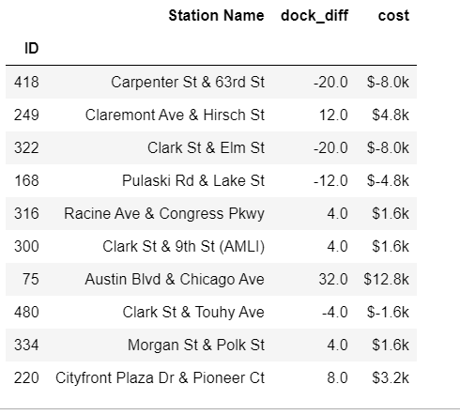
KNN Classification
Models for new dock need prediction
Logistic Regression
Naive Bayes
-> Conclusion: Assuming $400 for each dock using KNN model classification it is estimated that Divvy can save $ 3M if setup dock as per prediction made by this model.
-> There are 281 docks which require extra docks and if implemented can serve to customer in better way.
-> Conclusion: Assuming $400 for each dock using logistic regression, it is estimated that Divvy can save $ 46,800 if setup dock as per prediction made by this model.
-> 281 docks which require extra docks.
-> Conclusion: Assuming $400 for each dock using logistic regression, it is estimated that Divvy can save $ 5,28,400 if setup dock as per prediction made by this model.
-> There are 287 docks which require extra docks.
RESULT
Out of three ML algorithms KNN Classification gives the best result. Majority of stations that needed upgrade in docks number are in Central Chicago where most probably daily office goers must be using divvy. Whereas stations that needs to cut short on number of docks are also identified which can be used to save money and use them for stations where there is need to increase docks.

Slide 11
Support Vector Machine
Models for predicting maintenance of bikes
Decision Tree
Random Forest
-> Conclusion: Assuming 2019-01-17 as the date to check, using SVM it is estimated by the model that Divvy can put 13 bikes on maintenance to ensure apt availability.
-> The accuracy of SVM for prediction is 69.27%.
-> Conclusion: Assuming 2019-01-17 as the date to check, using Decision tree it is estimated by the model that Divvy can put 7 bikes on maintenance to ensure apt availability.
-> The accuracy of Decision Tree for prediction is 82.15%.
-> Conclusion: Assuming 2019-01-17 as the date to check, using Random Forest it is estimated by the model that Divvy can put 3 bikes on maintenance to ensure apt availability.
-> The accuracy of Random Forest for prediction is 76%.
RESULT
Out of the given models Decision Tree provides the best result with the highest accuracy. The models predict the number of bikes and the bikeIds that can be put to maintenance by keeping in mind various factors to ensure that Divvy doesn’t lose revenue due to bike availability.

Slide 12
Ridge Regression
Models for predicting number of trips on hourly basis
Lasso Regression
ElasticNet Regression
-> Conclusion: Assuming number of trips to be straightly correlated to the availability of bikes, ridge regression predicts the output on hourly basis.
-> RMSE value for the test data:
0.6189368
-> Numerical data has been normalized.
-> Conclusion: Assuming number of trips to be straightly correlated to the availability of bikes, ridge regression predicts the output on hourly basis.
-> RMSE value for the test data:
0.6183471
-> Numerical data has been normalized.
-> Conclusion: Assuming number of trips to be straightly correlated to the availability of bikes, ridge regression predicts the output on hourly basis.
-> RMSE value for the test data : 0.6180832
-> Numerical data has been normalized.
RESULT
Out of three algorithms ElasticNet Regression gives the best result. This can be inferred on comparison by the Root Mean Square Error. The least value of RMSE is for ElasticNet.

Slide 13
MODEL 1
MODEL COMPARISION
MODEL 2
MODEL 3
MODEL 4
Accuracy %
Accuracy %
RMSE (error)
KNN
KNN
SVM
Lasos
Ridge
Decision Tree
ElasticNet
Multi Reg & Corr
Logistic Regression
Naive Bayes
Random Forest
Logistic Regression

Slide 15
For different requirements, different algorithm proves to be optimum.
For the first two problems KNN classification seems to be optimum to provide prediction for the number of new docks at station as well as prediction for new station.
The last two problems were optimally solved with a different approach as, decision tree rightly predicted which bikes should be put to maintenance and when.
Whereas, ElasticNet optimally predicted the availability of bikes on hourly basis.
While building models remain a challenge, preparing the data and getting it ready for the models proves to be a bigger challenge.

Slide 16
LESSON LEARNED AND NEXT STEPS
Filtering and fetching out the required attributes from API is a more efficient and easier way to deal with larger data than dealing with CSV data files.
Framing business problems can be difficult without background information.
3. Date manipulations can be very tricky and sensitive depending on the problem statement needs. (For example: the inculcation of day-light-savings in hourly data analysis).
4. Data acquisition can be a difficult task considering the confidentiality.
5. The future scope of our project involves including taxi, subway, high schools, universities, office timings, restaurant, retail shop datasets as we assume there could be a strong correlation between demand for cycles with these datasets.

Slide 17
QUESTIONS?

